Slide 1
WE WERE PROMISED JETPACKS
An Introduction to Android Wear Dev
Rob Spectre, Director of Devangelism
@dN0t – rob@twilio.com

Slide 2
STORY TIME

Slide 3
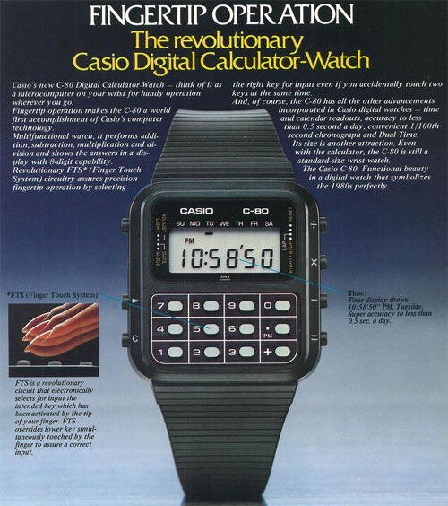
FINGERTIP OPERATION
Notes:
- When I was 10, the Casio calculator watch became "affordable" for the
first time.
- For $100, you could sport an arithmetically awesome accessory that
would let you burn through your multiplication tables in no time.
- Now, for me growing up in a trailer park, $100 might as well have been
a billion dollars - an impossible amount of money that ensured the
calculator watch would never be in my possession.

Slide 4
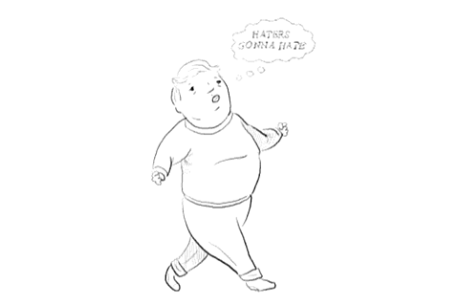
THIRD GRADE ROB
Notes:
- Which made me want it so much more.
- I would lay awake dreaming about how boss I would look with a
calculator watch. Roll into the classroom, say "Yo - you need some
shit calculated? Well let me just consult my *wrist*."

Slide 5
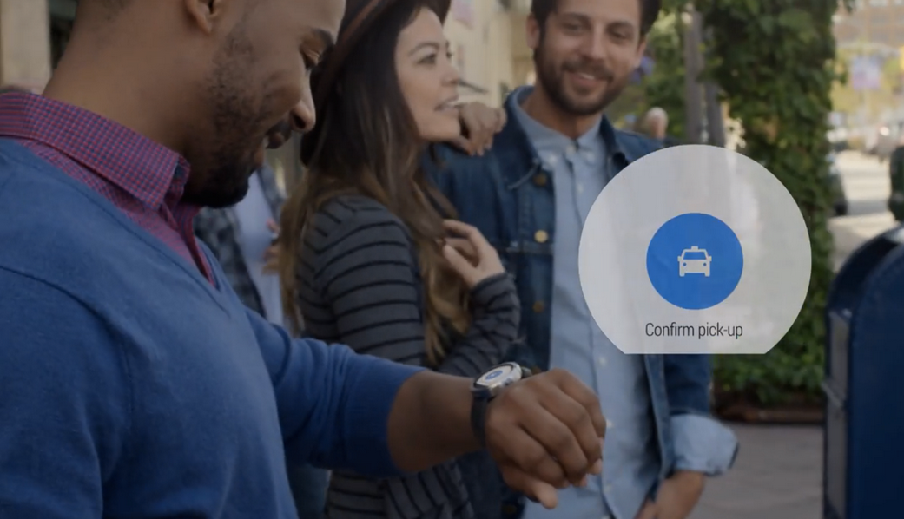
STOCK PHOTO
Notes:
- Flash forward to this summer
- Friggin' everyone is coming out with boss watches
- 10 year old Rob's envy popped out of my cerebrum with full psychic
force.
- It's a boss watch! That does things! And I can afford it! Holy
biscuits!

Slide 6
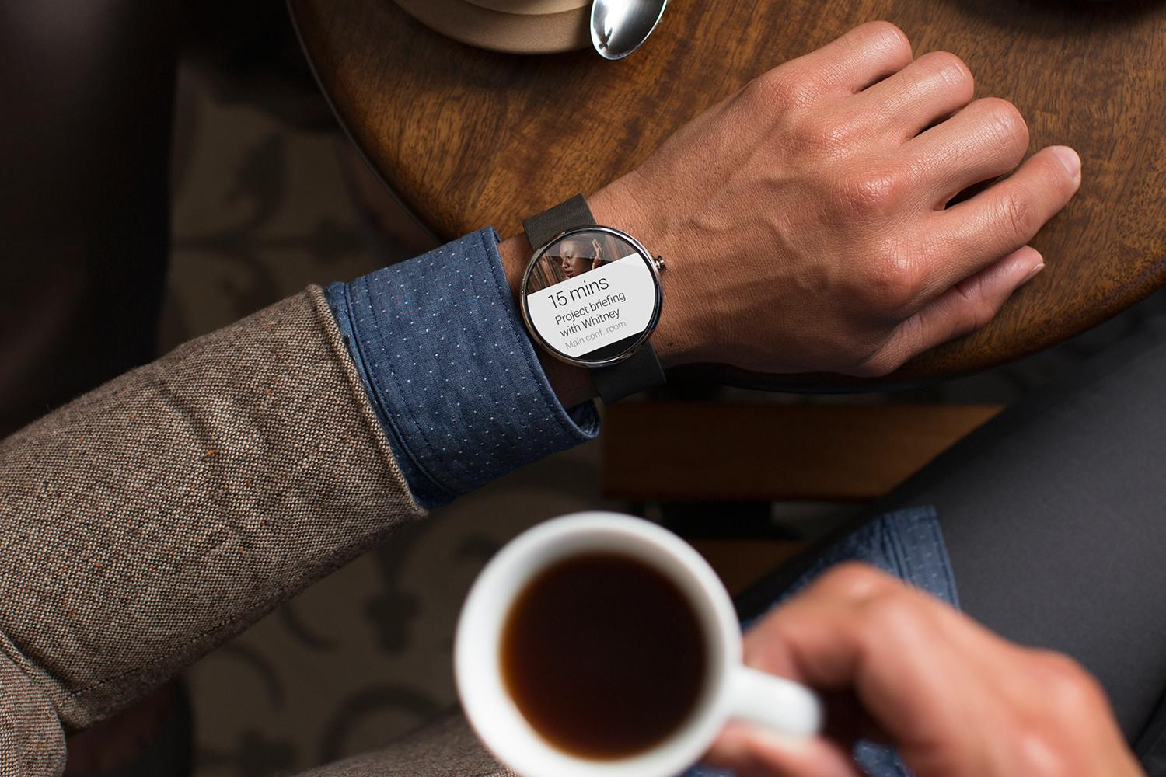
FUTURE COFFEE

Slide 7
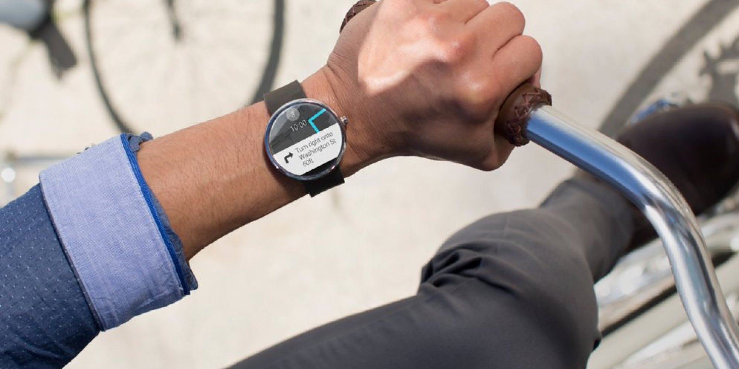
FUTURE BIKING

Slide 8
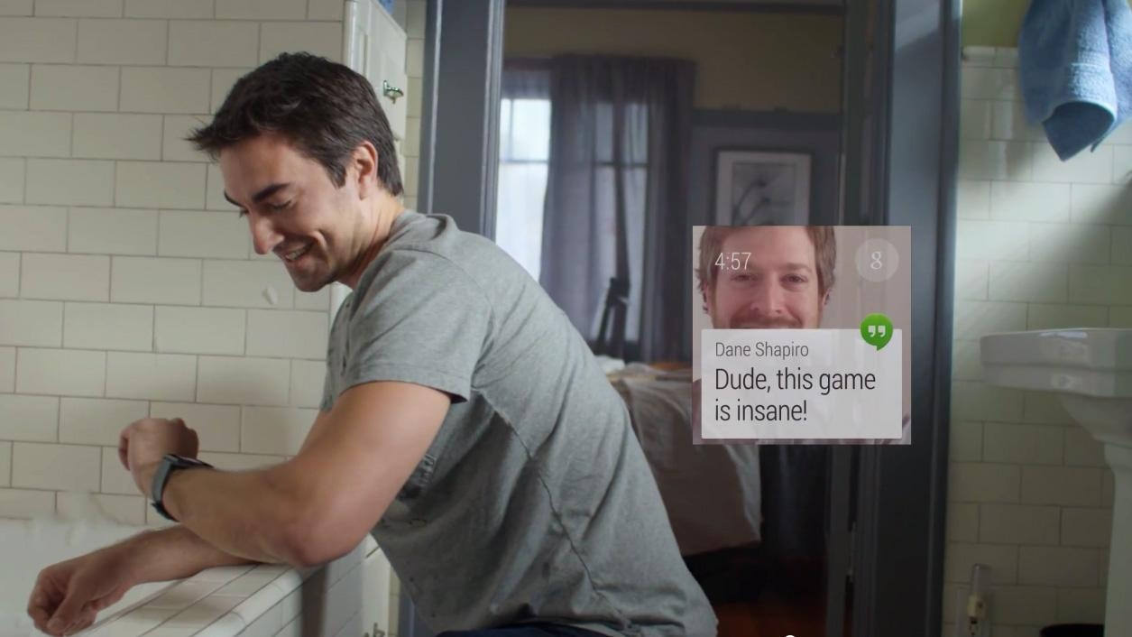
FUTURE BUBBLE BATHING

Slide 9
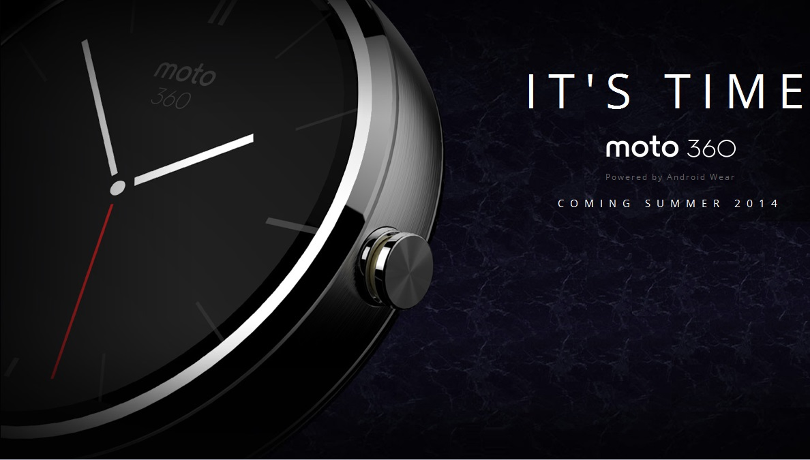
SUMMER ISH?
Notes:
- I walked out of there thinking, "Yo - you need to see the future?
Well let me just consult my *wrist*."
- I tell you all this because you need to understand, I was the most
enthusiastic supporter of the smart watch before they were released
this summer.

Slide 10
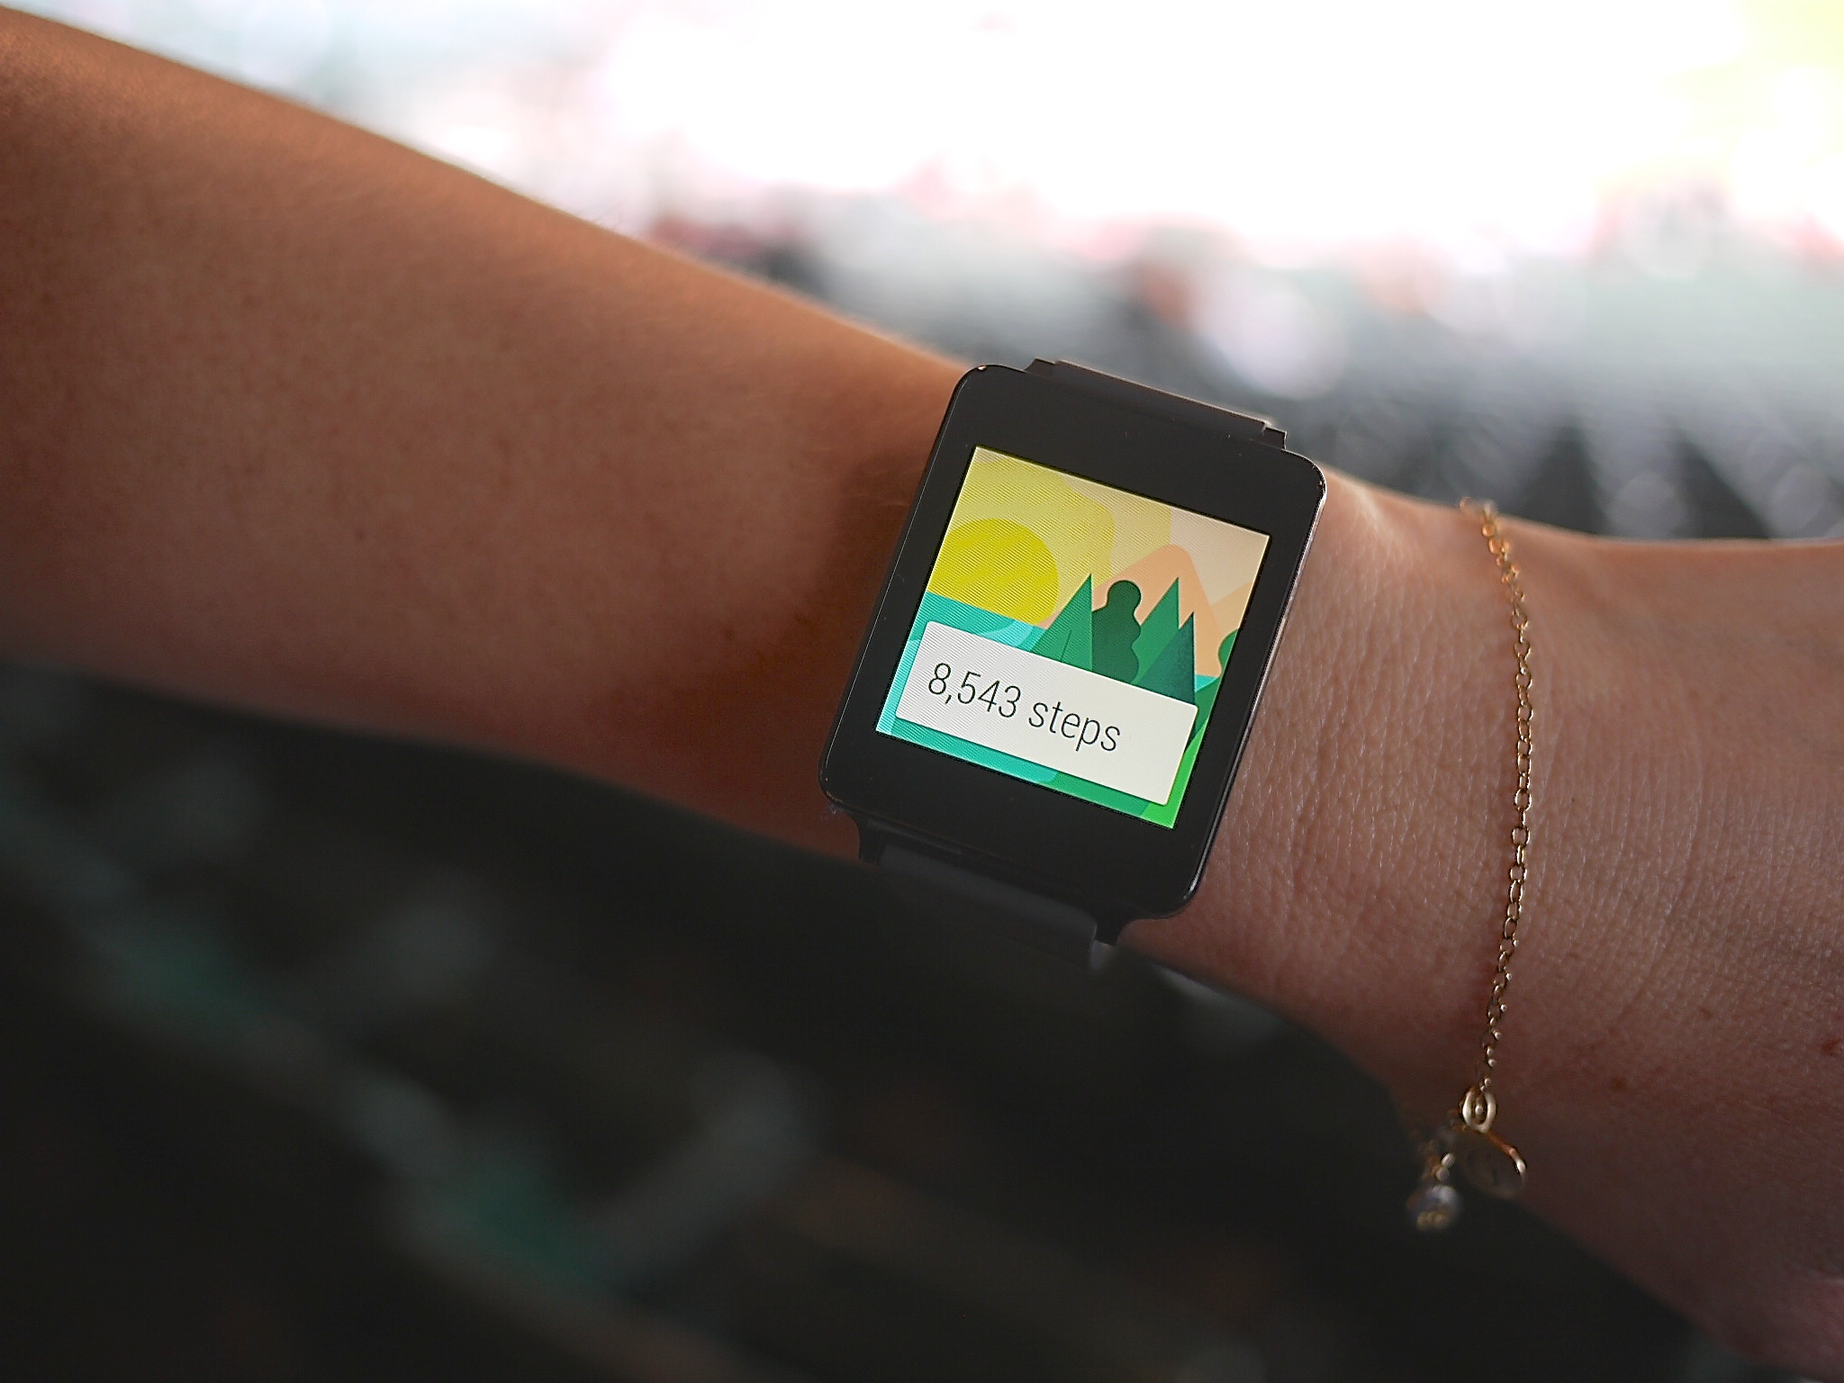
SAD TROMBONE
Notes:
- But like many of you, that enthusiasm was shortlived.
- Instead of the device that would finally fulfill the 20 year envy I
suffered from grade school, we got Google Glass for the wrist.

Slide 11
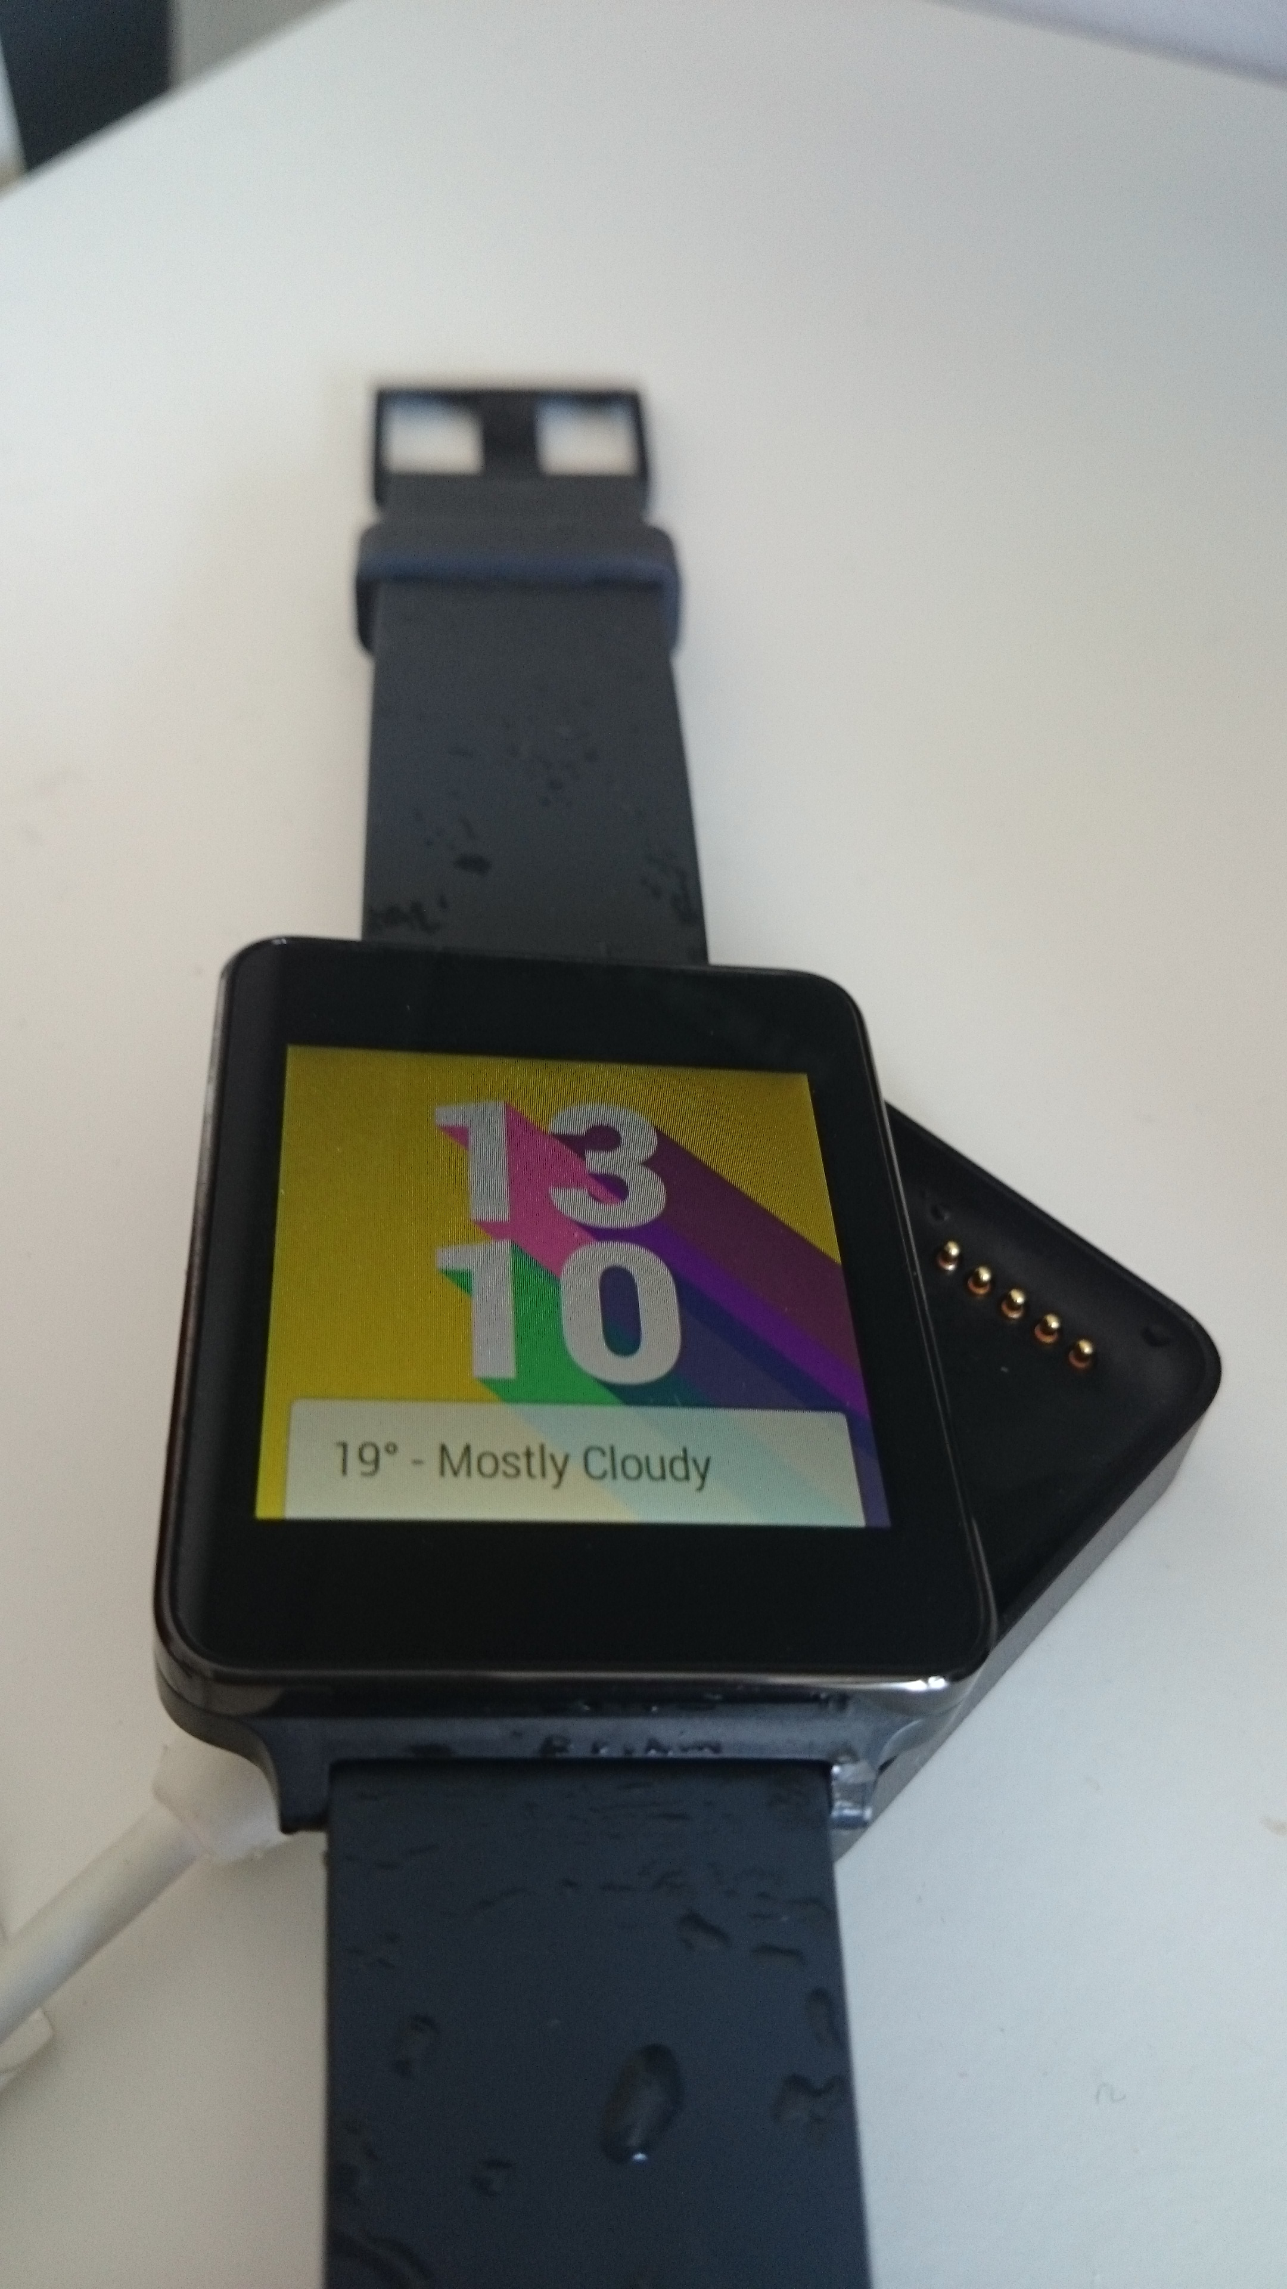
CHARGER TROMBONE
Notes:
- It was bigger than we anticipated
- It's battery life meant you had to recharge it with a bulky charger
every night.

Slide 12
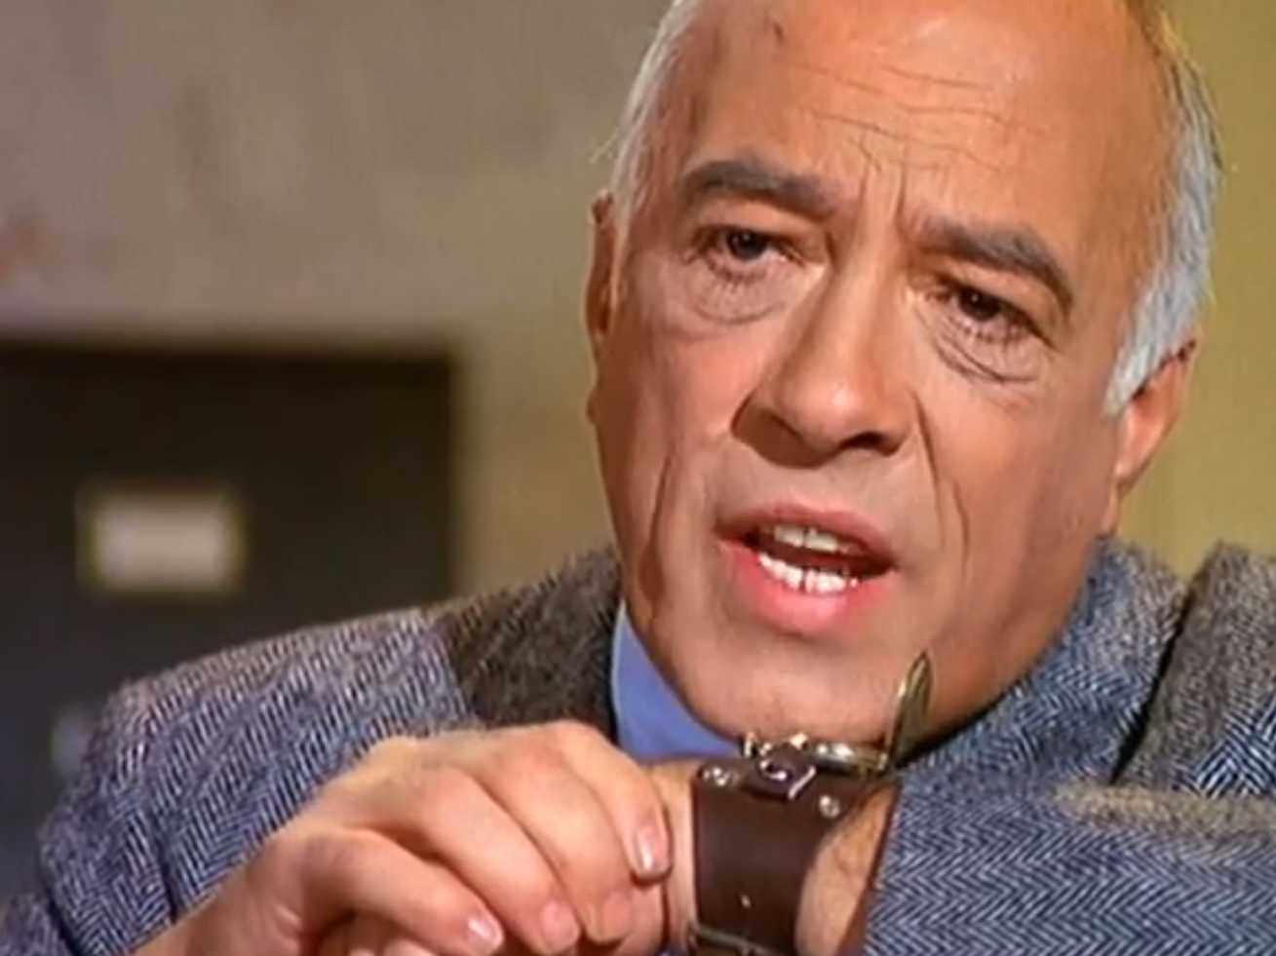
OLDER STOCK PHOTO
Notes:
- And it was depressingly short on the Jetsons type features we've all
been waiting for.

Slide 13
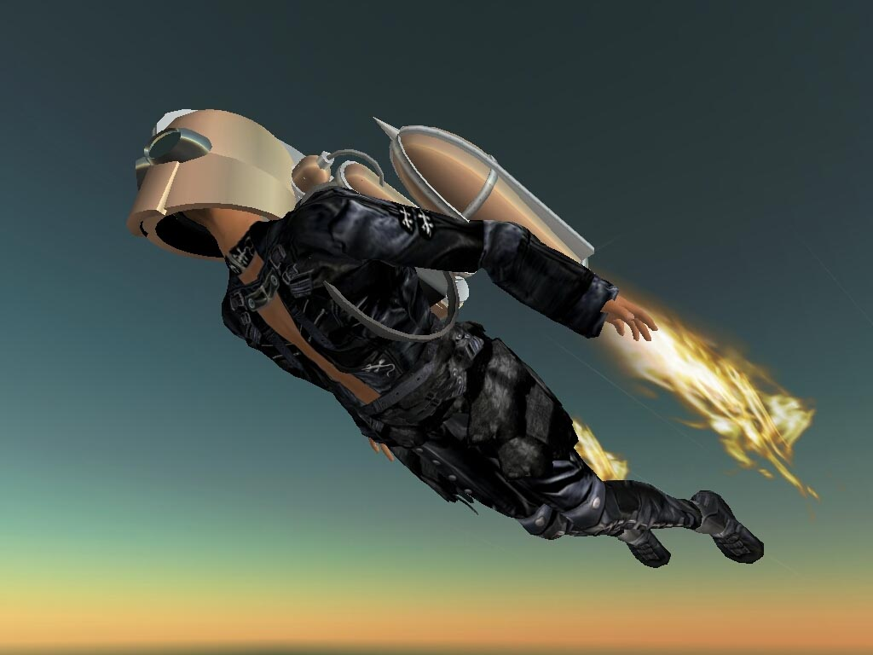
WE WERE PROMISED JETPACKS

Slide 14
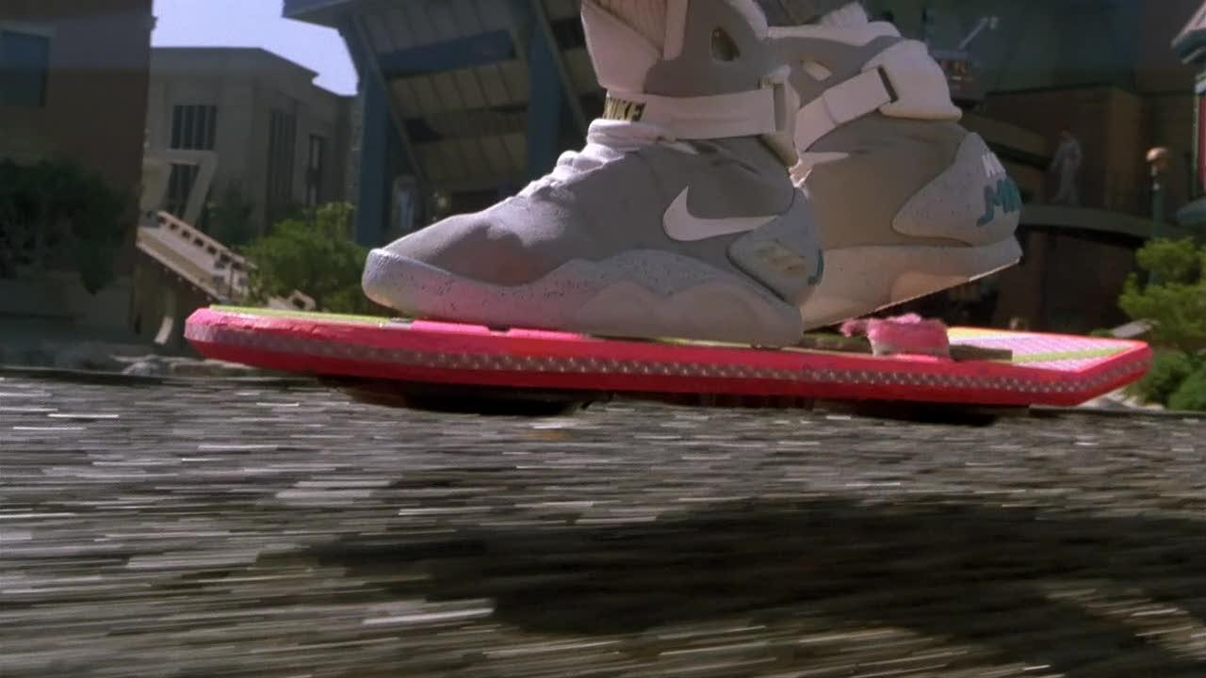
WE WERE PROMISED HOVERBOARDS

Slide 15
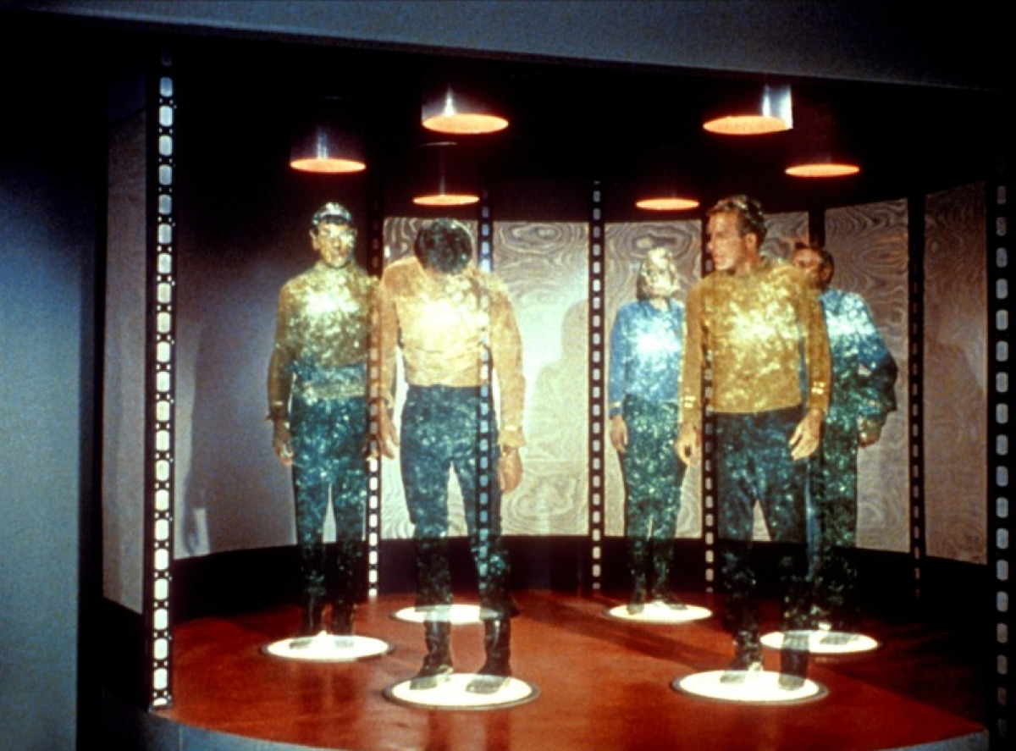
WE WERE PROMISED TELEPORTS

Slide 16
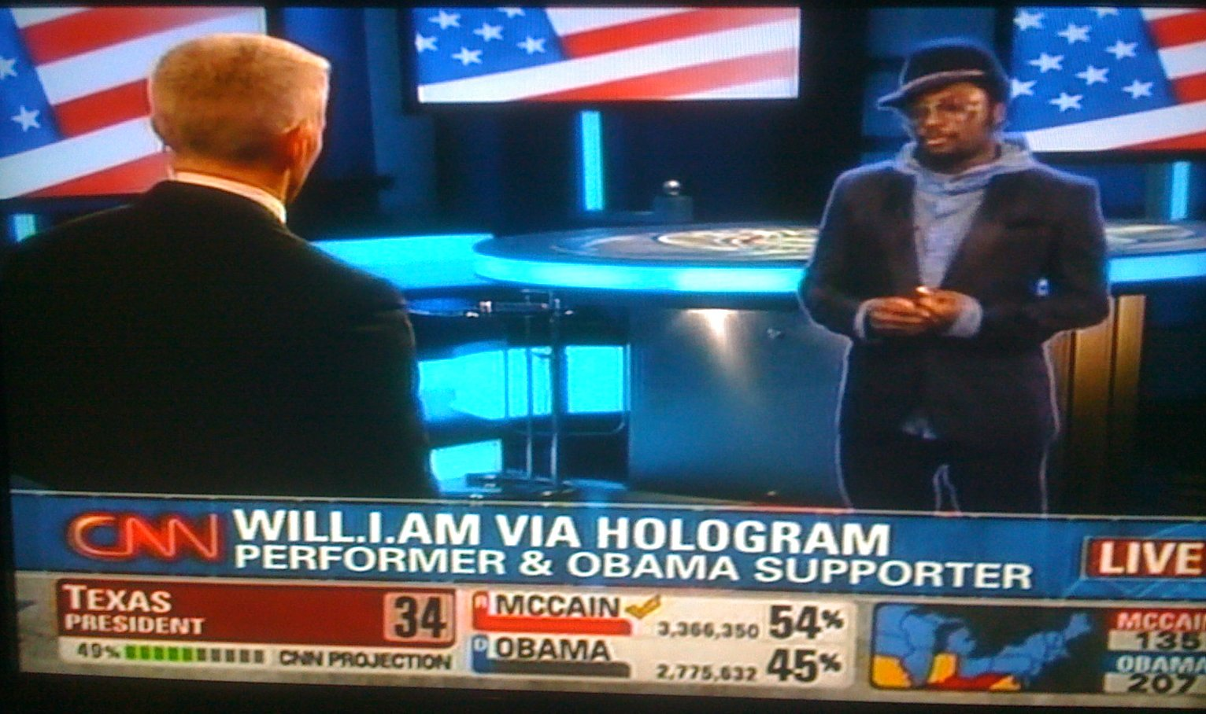
WE WERE PROMISED HOLOGRAMS

Slide 17
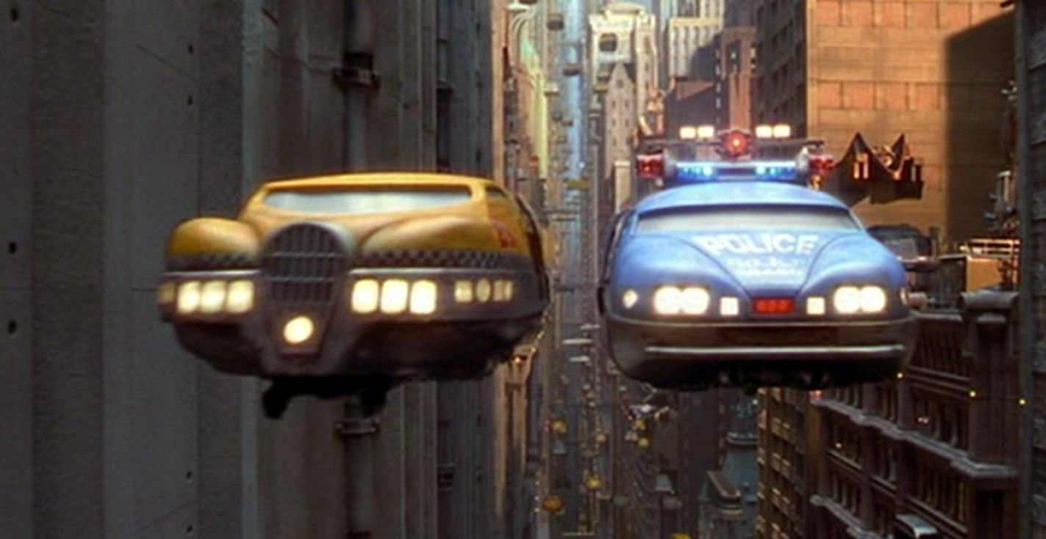
WE WERE PROMISED MULTIPASS

Slide 18

ARCOS RULE

Slide 19
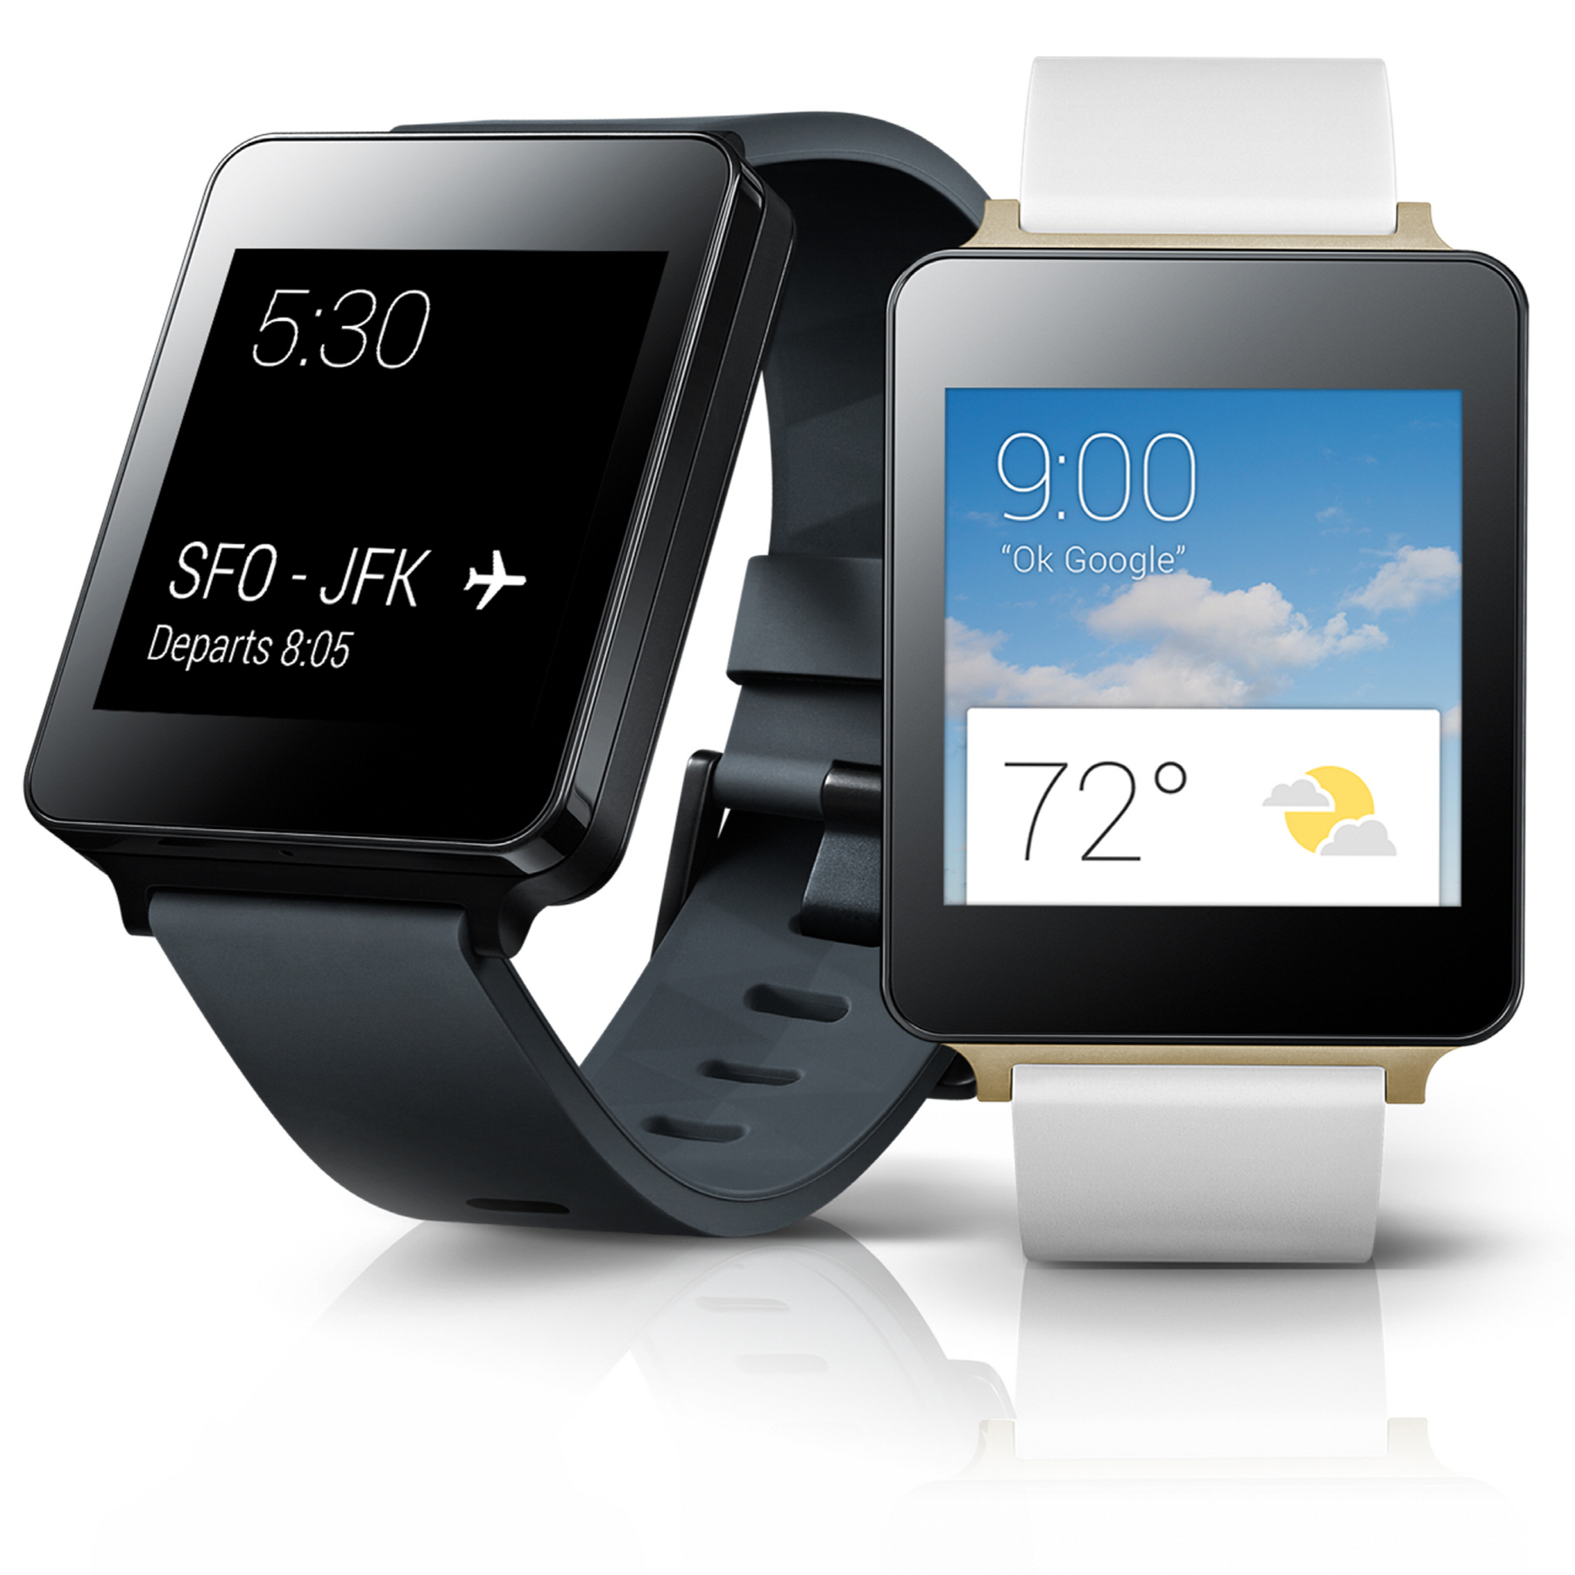
WOMP WOMP
Notes:
- And instead we got the smatch
- A hunk of plastic that looks like it was issued by a correctional
facility

Slide 20
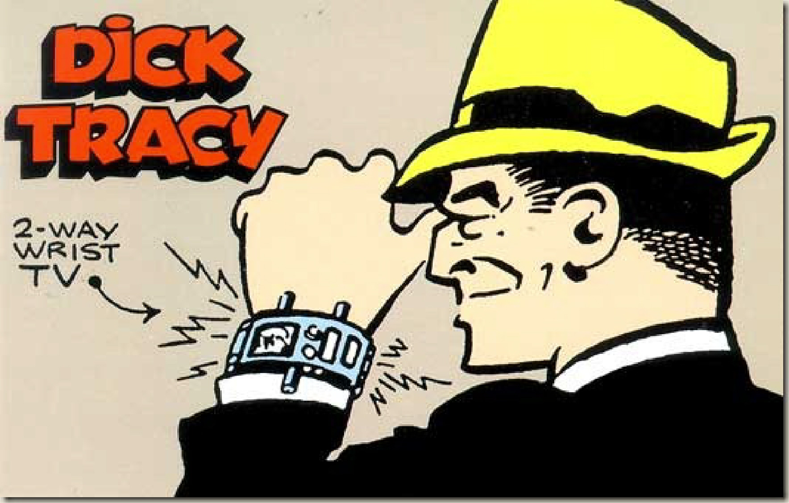
2 WAY? SWEET
Notes:
- That doesn't even have feature parity with Dick Tracy.
- Issue with the first watch face I liked

Slide 21
OPTIMISM
Notes:
- Cause for optimism
- It is clear the platform makers - that is to say the manufacturers and
Apple and Google - have their hands full making the device work

Slide 22
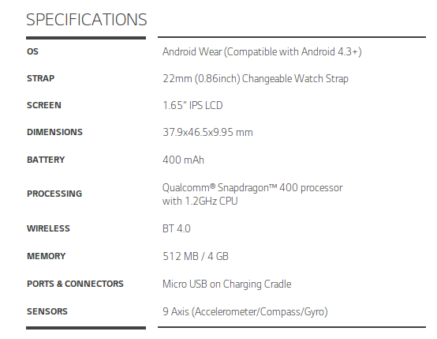
TIGHT QUARTERS
Notes:
- Cramming a touchscreen, connectivity, CPU, GPU, sensors, microphone
and battery all onto your wrist is a stonkingly difficult problem

Slide 23
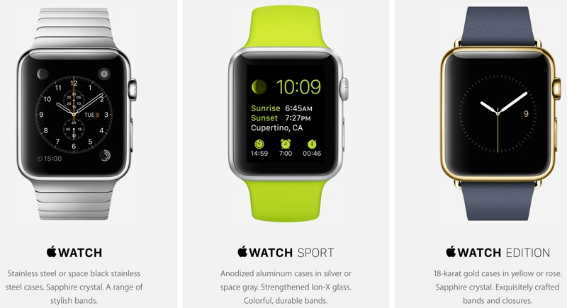
DISTINGUISHED COMPETITION
Notes:
- It is obvious from three months of Android Wear and the demonstration
earlier this month from Apple, both platforms haven't figured out how
to make it useful yet

Slide 24
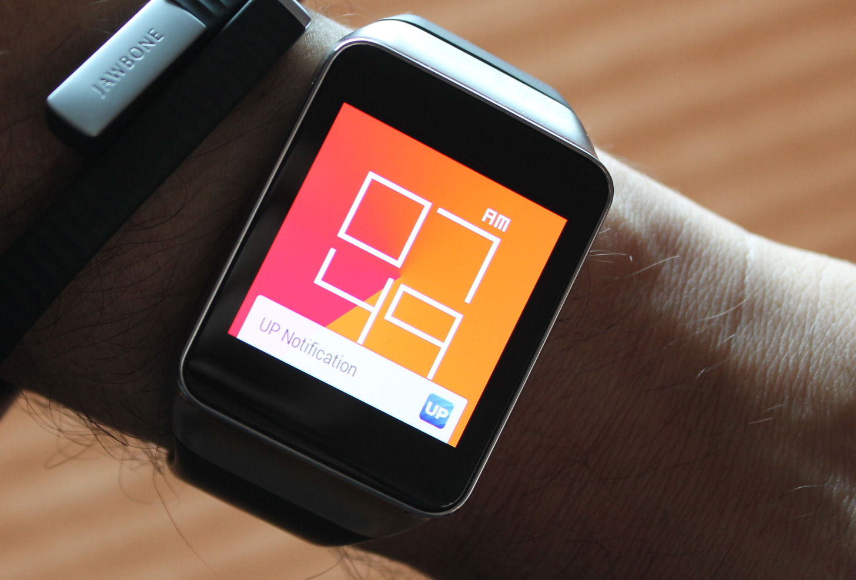
DUAL WIELD
Notes:
- That is an extraordinary opportunity for developers

Slide 25

HAM FISTED METAPHOR
Notes:
- We don't get green fields on new form factors very often.
- This isn't like a tablet, it's a fundamentally different form factor.
- And that should have all of us very stoked.

Slide 26
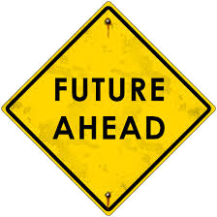
HAM FISTED METAPHOR #2
Notes:
- If there is going to be a future for the smatch, that future is in our
hands.

Slide 27
O HAI

Slide 28

SWEET GIG

Slide 29
DEVICE
DEV OVERVIEW
NOTIFICATIONS
APPS
AGENDA
Notes:
- Introduction to Android Wear Development
- Usability
- Developing on Wear
- Resources and Tricks
- Conclusions

Slide 30
DEVICE

Slide 31
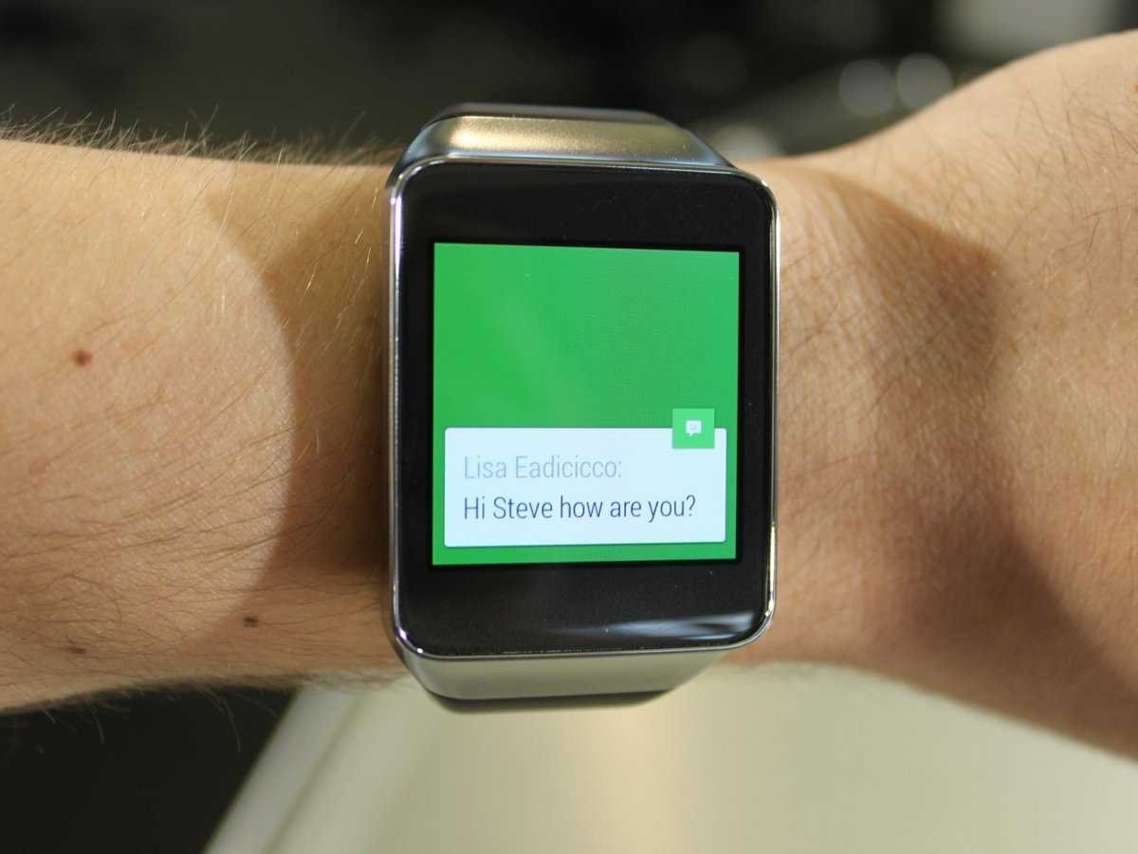
WRIST HAIR
Notes:
- Not a stand alone watch
- Married to your handset
- Communicates over bluetooth
- Apps serve as clients to the handset

Slide 32
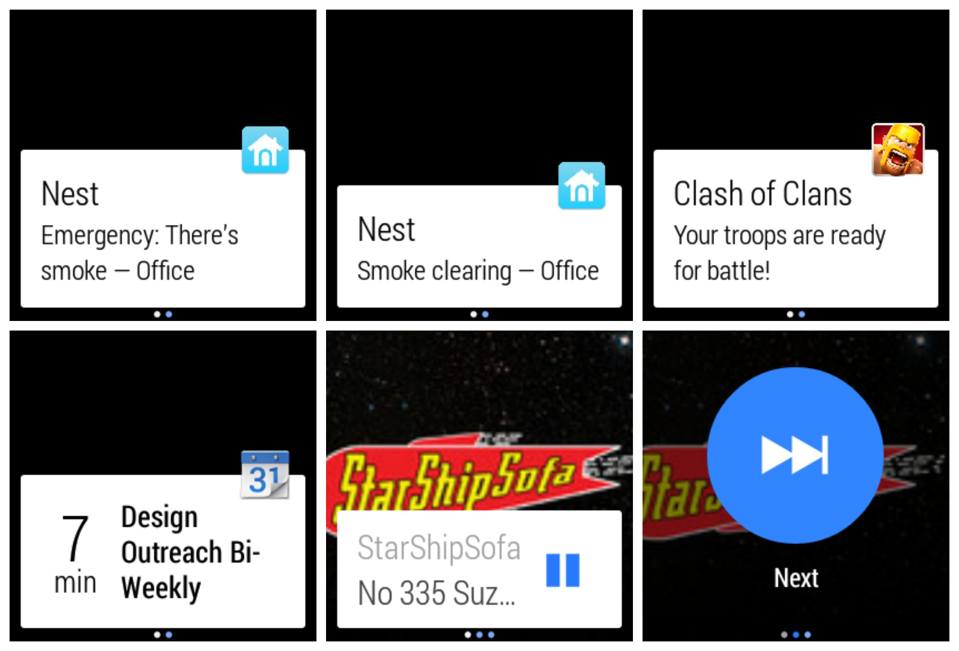
NOTIFICATIONS ALL DAY
Notes:
- Driven by notification cards - very familiar to Glass users
- Interaction is swipe / single button

Slide 33
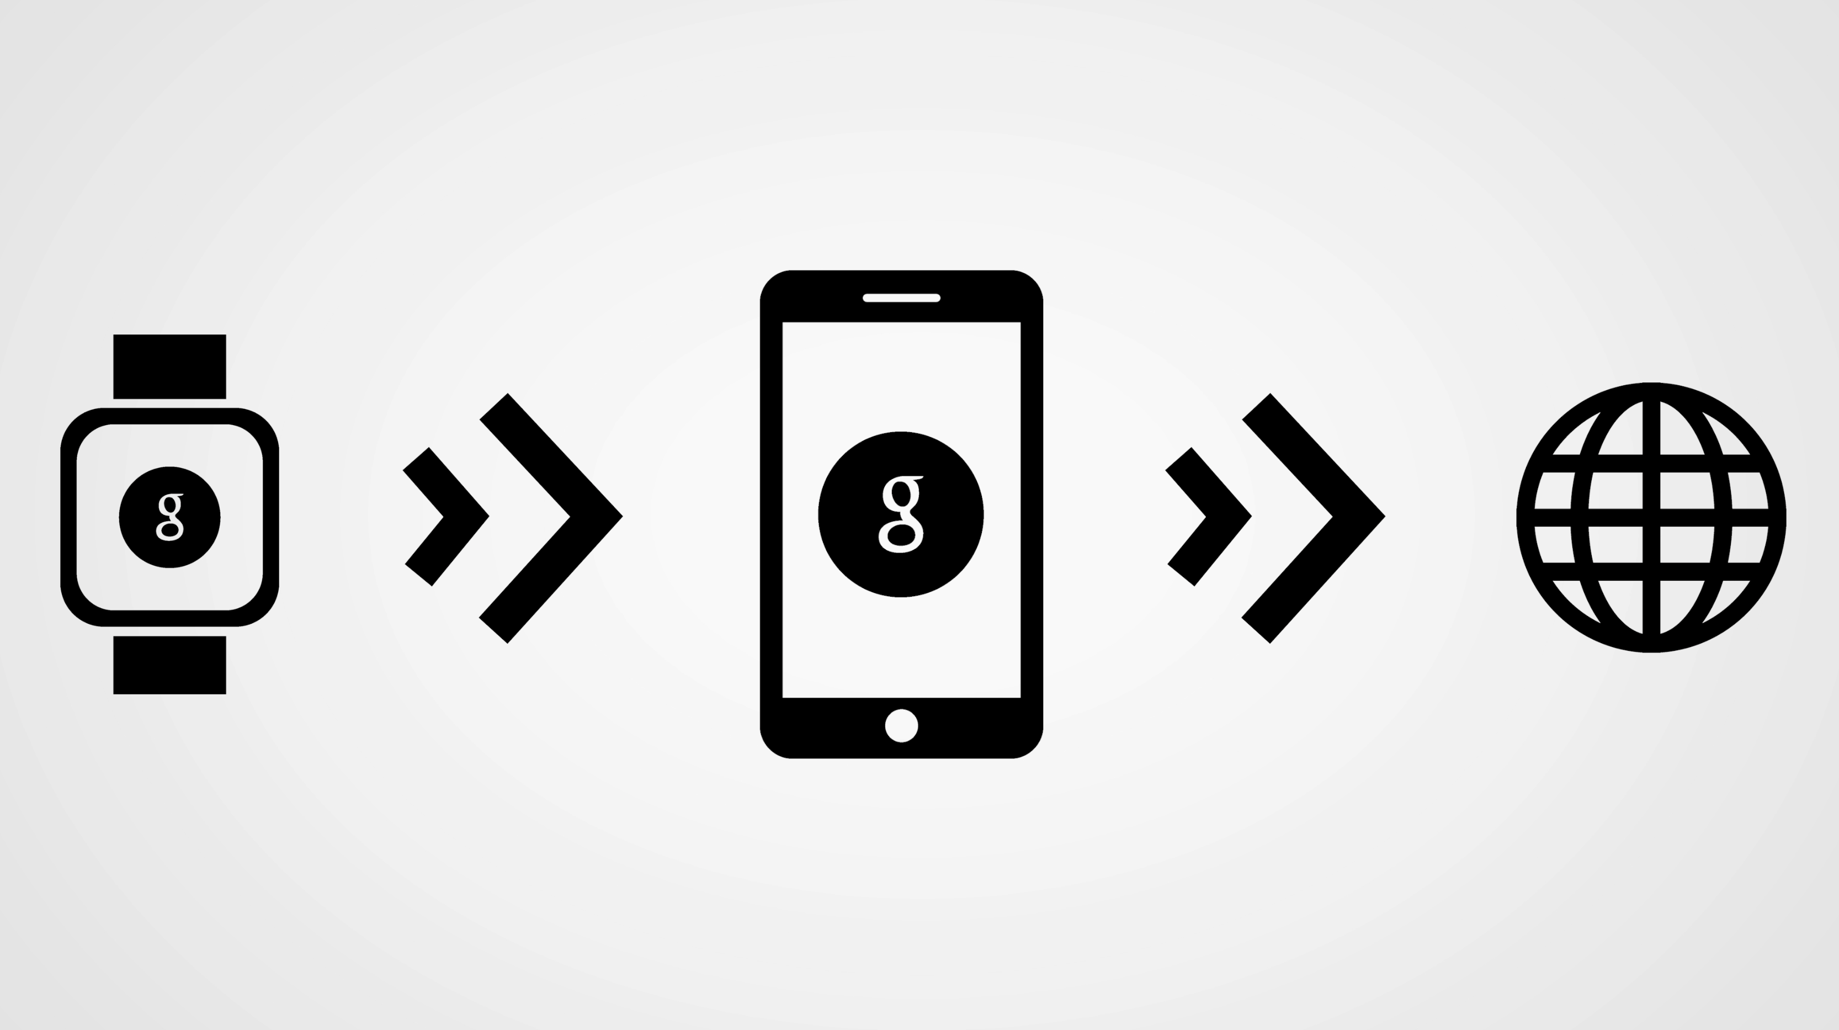
VOICE INPUT
Notes:
- Input is voice drive
- Voice recognition not nearly as fast as what is available on the
handset
- LG devices usually requires repetition to get the command you want

Slide 34
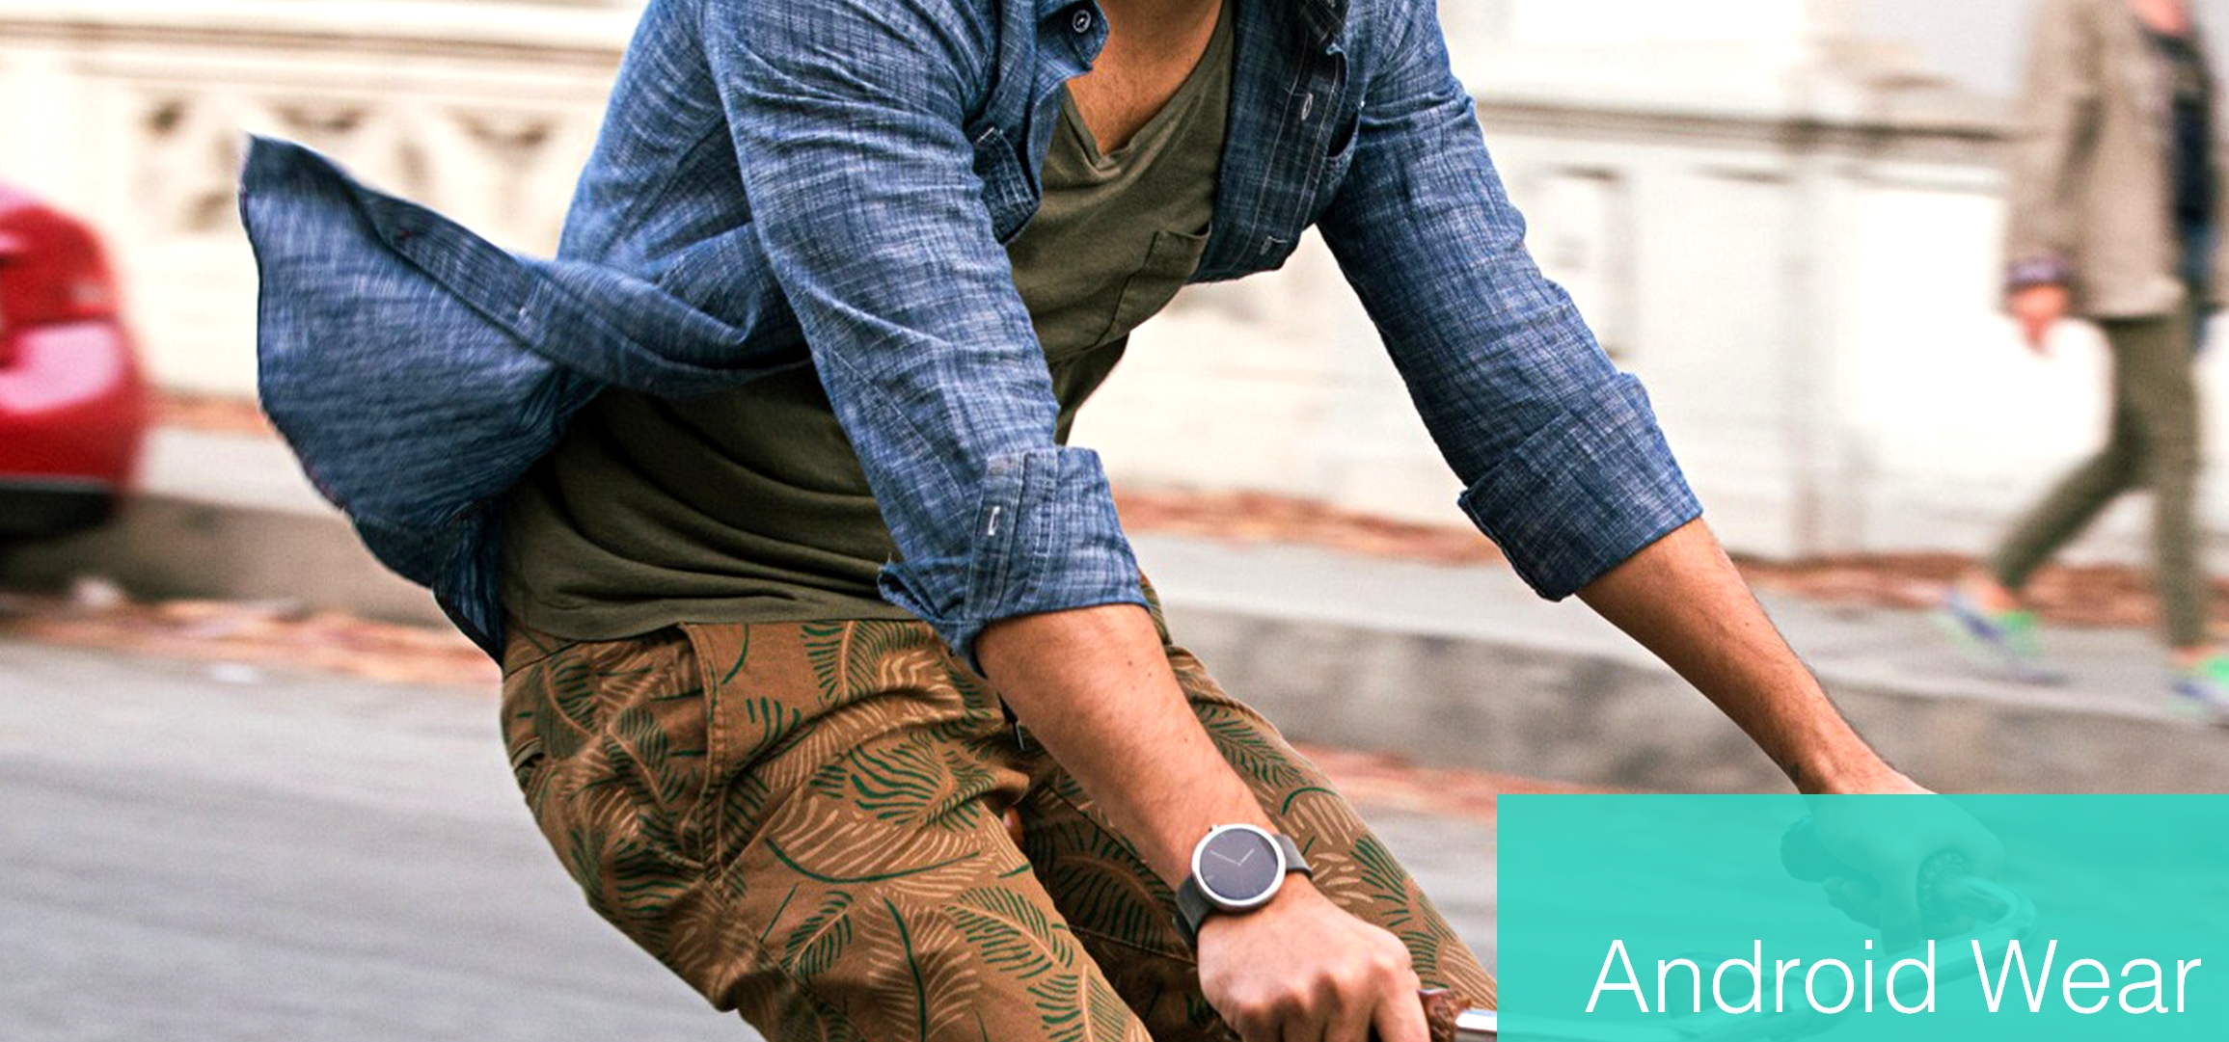
NICE PANTS
Notes:
- Still not essential; I forget it often when in a hurry to leave the
house.
- Drains the device - can't get a full work day out of a Nexus 5
- Default settings the LG watch will survive 13 hours

Slide 35
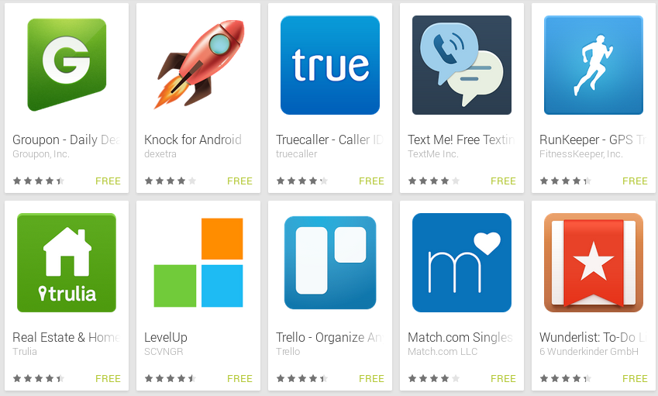
LOTSA APPS
Notes:
- It's pretty easy to make an existing Android app compatible with Wear.
- App ecosystem is definitely growing, but are mostly just
notifications.
- Most useful stuff so far are tickets, remote control and fitness.
- [Delta](https://play.google.com/store/apps/details?id=com.delta.mobile.android)
- [Amazon
Music](https://play.google.com/store/apps/details?id=com.amazon.mp3&hl=en)
- [RunKeeper](https://play.google.com/store/apps/details?id=com.fitnesskeeper.runkeeper.pro)
- Thoroughly unessential - I forget to wear it all the time
- Chatty apps get undeleted as a result of the unique social stigma of
having them on your wrist

Slide 36
DEV OVERVIEW

Slide 37
CLIENT OF A CLIENT
Notes:
- Will need to be bundled with a handset app
- Wear app serves as a client to your Android app
- Provides the connectivity and persistance
- Can sync objects, messages, and blobs between app and Wear through
DataLayer

Slide 38
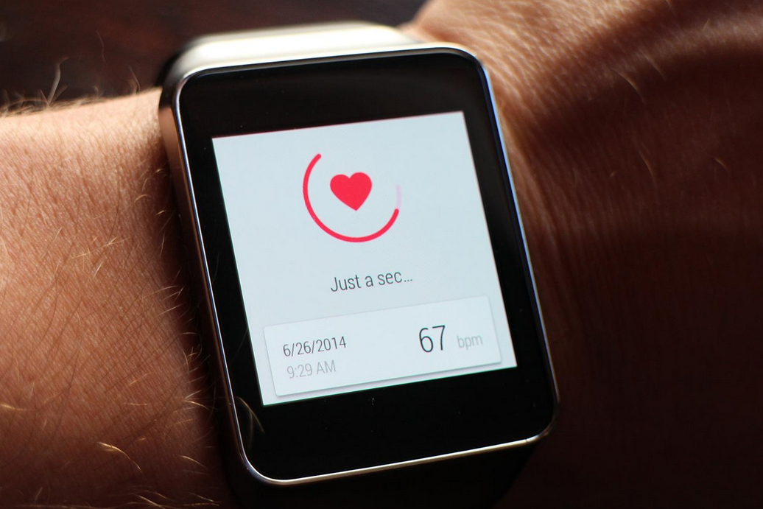
INTEGRATION OPTIONS
Notes:
- Android apps with Wear support
- Wear apps that actually run on the wearable itself
- Including the support for the former takes at most an afternoon
- Latter does require a switch to Android Studio

Slide 39
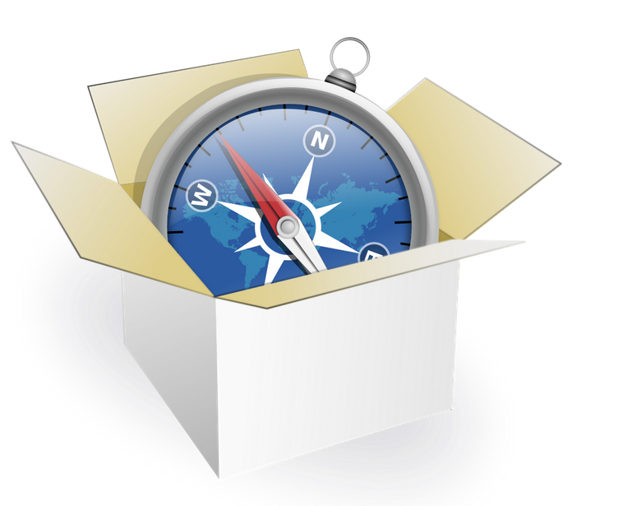
CONSTRAINTS
Notes:
- Apps go to sleep with inactivity
- Sleep jerks the user out of your app
- Persistent display can only be done through a notification
- Users find and install apps from the handset or the web, not on
the watch - important for distribution
- Lot of the API is unavailable - notably no webkit

Slide 40

GETTING STARTED
Notes:
- Need rev20 of the v4 support library that was released in July
- Comes with all the extensions for wearables, mostly with
NotificationCompat
- Also ships with improvements on SwipeRefreshLayout which you'll
want
- For use of DataLayer, you will need Play Services

Slide 41
NOTIFICATIONS

Slide 42
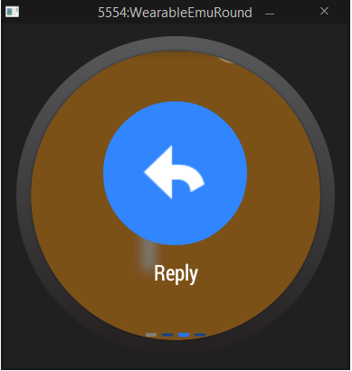
INTENT WITH ACTIONS
Notes:
- Card with primary intent
- Swipe of additional intents
- Single press action like archive / favorite / star / delete
- Free form input with speech recognition

Slide 43
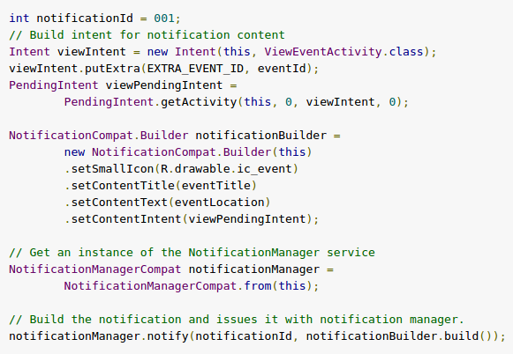
IMPLEMENTATION
Notes:
- Use NotificationCompat to build notifications and they show on the
wearable.

Slide 44
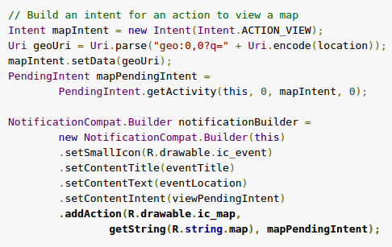
ADD A GEOLOCATION ACTION
Notes:
- Additional actions can be provided
- use addAction() to the builder to add multiple actions to the
notification
- They are accessed by the user by swiping left
- Demonstration using ic_map drawable

Slide 45
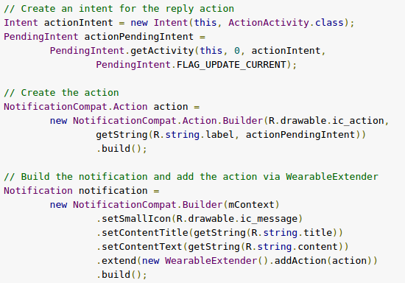
CUSTOMIZE FOR WEARABLES
Notes:
- Customizing output for the wearable
- Available using the WearableExtender
- Actions added using WearableExtender only appear on the wearable

Slide 46
APPS

Slide 47
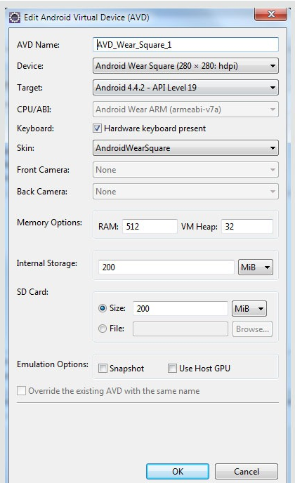
AVD NO BUENO
Notes:
- Emulator is still way buggy
- Most of your development you're going to want to do debugging over
Bluetooth
- AVD only available in Android Studio
- Does have square and round faces to glance at layouts
- Much like Android of old, you'll want to have the hardware handy

Slide 48
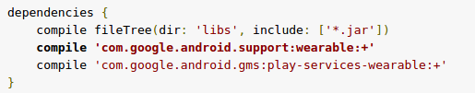
UNOFFICIAL OFFICIAL
Notes:
- Notifications is the only persistence on the device
- There is an unofficial library for creating your own in app
layouts
- Includes a BoxInsetLayout, and some activities and views to build
your interface.
- Has broken a few times already - Google makes no guarantee on
compatibility

Slide 49
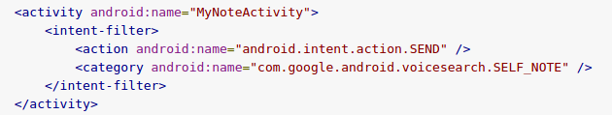
VOICE INTENTS
Notes:
- This is the most useful part of actually going to the trouble of
packaging an app
- You can declare intents for the system voice commands like "take a
note" or "call a car"

Slide 50
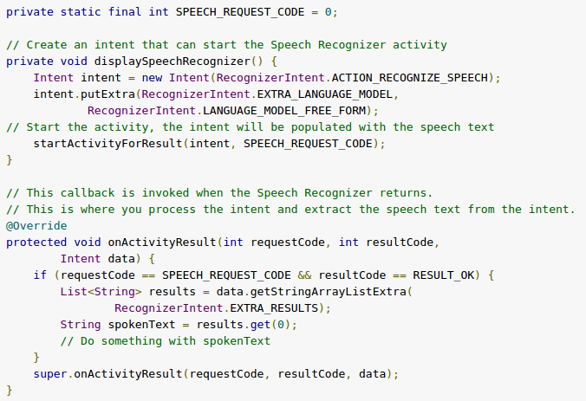
VOICE INPUT
Notes:
- This is the most useful part of actually going to the trouble of
packaging an app
- You can declare intents for the system voice commands like "take a
note" or "call a car"
- Or you can create actions for voice input and handle with a
callback

Slide 51
VOICE INPUT
Notes:
- This is the most useful part of actually going to the trouble of
packaging an app
- You can declare intents for the system voice commands like "take a
note" or "call a car"
- Or you can create actions for voice input and handle with a
callback

Slide 52
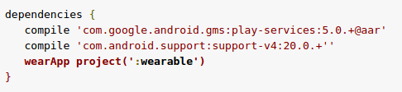
PACKAGING
Notes:
- Ultimately, the wear app must be bundled with a handset app for
the user to install.
- Wear users can't browse and install apps from the watch itself, it
is done through the handset and Play Store
- Packaging is pretty simple - just declare the wearable app as a
dependency in Gradle.

Slide 53
DATA LAYER

Slide 54
DataItem
Messages
Assets
OVERVIEW
Notes:
- Syncing is managed through the Data Layer API that comes with Play
Services
- You can sync Data Items, Messages and Assets.
- Accessible to the app through listeners
- Disconnects and syncs are handled by the Data Layer - you don't
have to worry about it

Slide 55
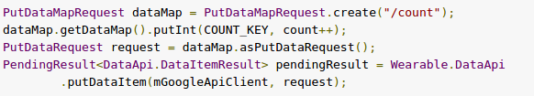
CREATING EVENTS
Notes:
- Uses Wearable.DataApi on the handset to relay to wearable
- Accepts DataItems, Messages and Assets.
- Example of datamap

Slide 56
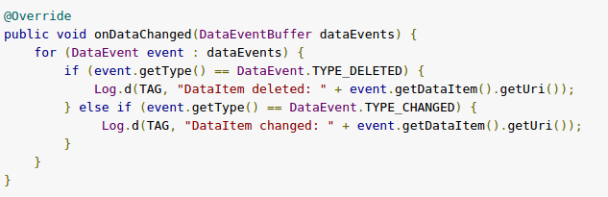
LISTENING FOR EVENTS
Notes:
- Can do sync and async waiting
- Available through WearableListenerService()
- You can listen for onDataChanged(), onMessageReceived(), on
disconnect and connect.

Slide 57
LISTENING FOR EVENTS
Notes:
- Ultimately, the wear app must be bundled with a handset app for
the user to install.
- Wear users can't browse and install apps from the watch itself, it
is done through the handset and Play Store
- Packaging is pretty simple - just declare the wearable app as a
dependency in Gradle.

Slide 58
CONCLUSIONS

Slide 59
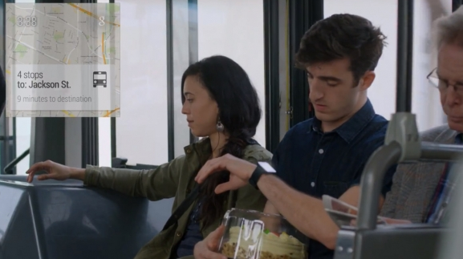
NOT THERE YET
Notes:
- Ultimately, the wear app must be bundled with a handset app for
the user to install.
- Wear users can't browse and install apps from the watch itself, it
is done through the handset and Play Store
- Packaging is pretty simple - just declare the wearable app as a
dependency in Gradle.

Slide 60
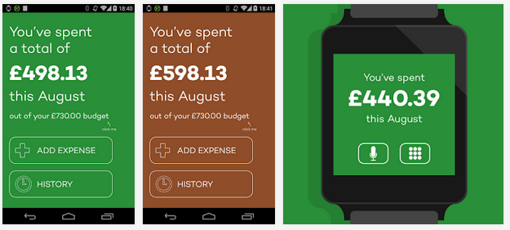
PROMISING HACKS
Notes:
- Ultimately, the wear app must be bundled with a handset app for
the user to install.
- Wear users can't browse and install apps from the watch itself, it
is done through the handset and Play Store
- Packaging is pretty simple - just declare the wearable app as a
dependency in Gradle.

Slide 61
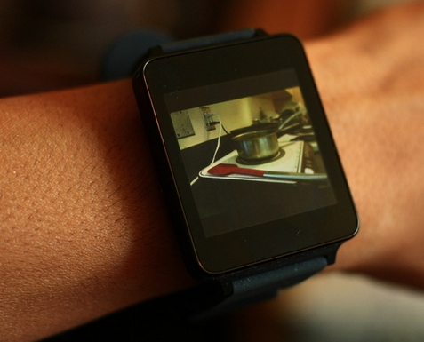
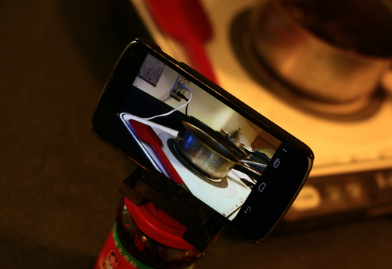
PROMISING HACKS
Notes:
- Ultimately, the wear app must be bundled with a handset app for
the user to install.
- Wear users can't browse and install apps from the watch itself, it
is done through the handset and Play Store
- Packaging is pretty simple - just declare the wearable app as a
dependency in Gradle.

Slide 62
WE WERE PROMISED JETPACKS

Slide 63
THANK YOU
Github.com/RobSpectre/Talks
www.brooklynhacker.com
@dN0t – rob@twilio.com

